Slide 1


Technical Writing
Unit 2

Slide 2
Revisiting Organization
Organization refers to the arrangement and presentation of the ideas
01
Shows how the sentences and the paragraphs are written and placed
02
Related to the structure of writing
03

Slide 3
The Place of Organization in Writing
Preparation (Establishing primary purpose. Assessing audience. Determining the scope of the coverage. Choosing the appropriate medium. Deciding on format and style of the presentation.)
Research (Surveying a topic using primary and secondary sources. Carrying out primary and secondary research to develop the content.)
Organization (Determining the best way to structure ideas. Presenting the collected materials. Choosing the best method of development. Outlining. Layout and Design. Formatting (how the text looks))
Writing (Expanding the outline into the sentences and paragraphs. Preparing a rough draft.)
Revision (Reading and evaluating the draft. Checking for unity and coherence, accuracy, completeness, and effectiveness in achieving your purpose and meeting your readers’ needs and expectations. Proofreading for mechanical errors like, punctuation and spelling.)

Slide 4
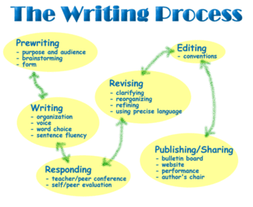
WRITE FOR YOUR AUDIENCE Your reader is your reason for writing. So, ask yourself some basic questions: 1 Who is my reader? What does my reader know about this subject? What does the reader need to know? How will the reader respond? Will he or she be receptive? Will he or she object? Will he or she be hostile? Will he or she be indifferent? Make some notes about your reader, as a guide. This will help you ensure that you have your reader firmly in mind which will, in turn, give your writing the proper focus.

Slide 5
A Word of Advice
START WITH A CLEAR, CONCISE MESSAGE STATEMENT
It will help to ask yourself exactly what you want to communicate.
Get down to the core of your message.
Before you write your message in a single sentence, ask yourself some basic questions: What do I need to tell the reader? What do I want to accomplish with this message? How do I want the reader to respond? What do I want the reader to do after reading my communication? Then crystallize the intent of your message by looking closely at your own motive in writing. Ask yourself what you want your message to accomplish. Do you want to inform the reader? What information do you want to give? Do you want to persuade the reader? Of what? Motivate the reader to take some action? Apologize to the reader? For what? Or, is your purpose to follow up on or confirm a verbal discussion, or to simply create a written record?
Most of your messages will be to inform or persuade; sometimes you will want to motivate.

Slide 6
Cont.…
Examine your text for ways to make it visually more appealing:
Use boldface headings in a larger type size to draw the reader's interest and help him or her focus on the subject.
Use white space to create the impression that your communication is easy to read.
Use underlining, indenting, and varied but consistent spacing to break up the density of the text and help the reader scan for specific information.
Decide which elements of your communication should be reinforced in graph or chart form and create these.
Decide if a lot of your information can be distilled into table form for easy, immediate understanding.

Slide 7
Organization in Action
It's time to begin to put your thoughts in order.
USE A CLEAR, LOGICAL PROGRESSION When you began thinking about writing, you had some ideas in mind. Maybe you even made some notes—a very good practice. Write down the main points, or parts, of your communication in the most logical order. You can put your ideas into your computer, or you can use index cards and write them out by hand. But start to think about organization and form your headings in as logical an order as possible. Then list subpoints: (1) Be consistent with the information and the background of your reader, (2) order your outline the way your reader most likely thinks about the subject, or (3) order it chronologically or develop-mentally. By organizing your thoughts on the basis of what the reader needs to know about the subject and what you want the reader to do after reading your communication will become effective.

Slide 8
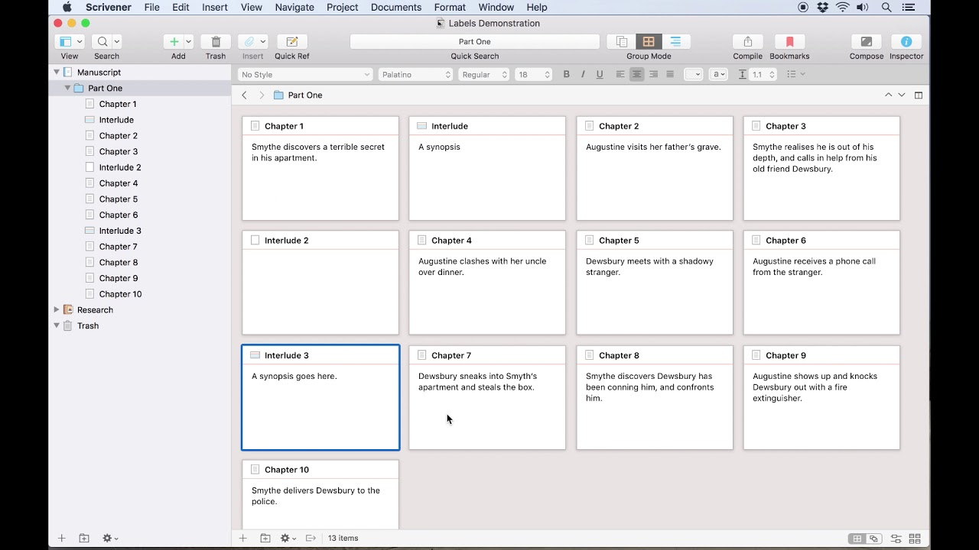
Cutting Short!
Organization is essential to make writing effective and to satisfy the needs of the target audience
To serve the intent and precision of Technical Writing
Steps: Outlining, using a logical and appropriate method of development, layout and design, determining the format, aiding with visuals)
Outlining:
the skeleton of the document you are going to write
a road map
a list of headings, sub-headings, points or descriptions
helps to organize and develop the ideas
visualizing the paper's potential structure

Slide 9
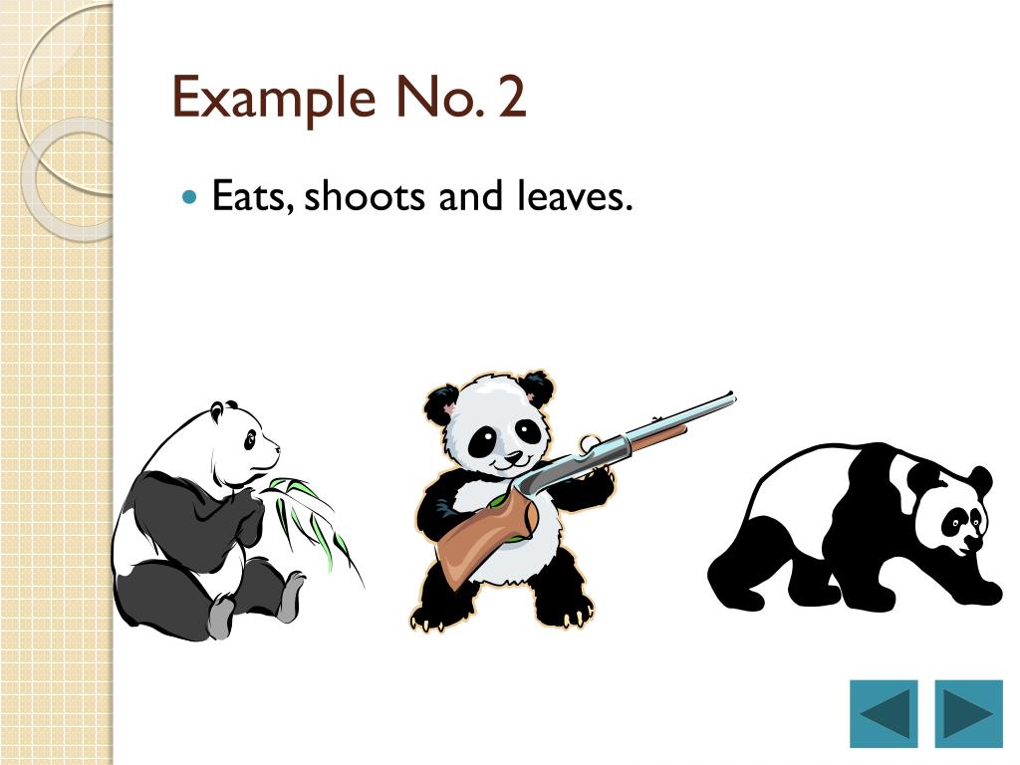
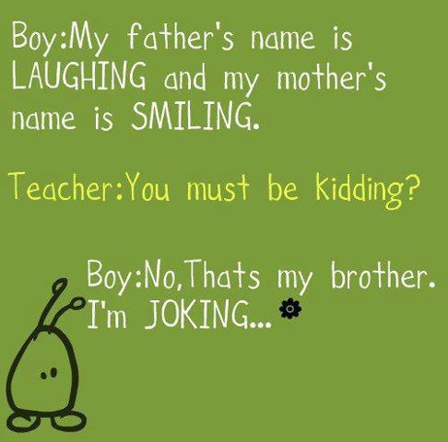
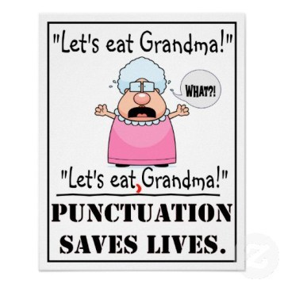
Time for Technical Jokes!

Slide 10
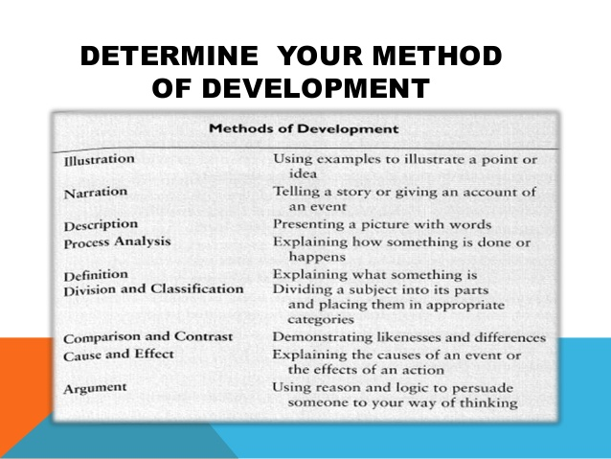
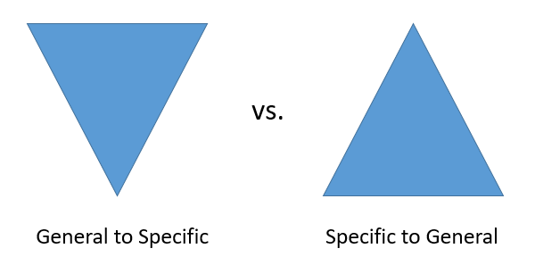
Methods of Development
Used for a logical arrangement of ideas from the Introduction to the Conclusion
Selected to suit audience and purpose
Common methods: Cause-and-effect method of development, Chronological method of development, Comparison method of development, Definition method of development, Division-and-classification method of development, General and specific methods of development, Order-of-importance method of development, Sequential method of development
When outlining a document, one may base his/her major division on one primary method of development appropriate to his/her purpose and then subordinate other methods to it.

Slide 11
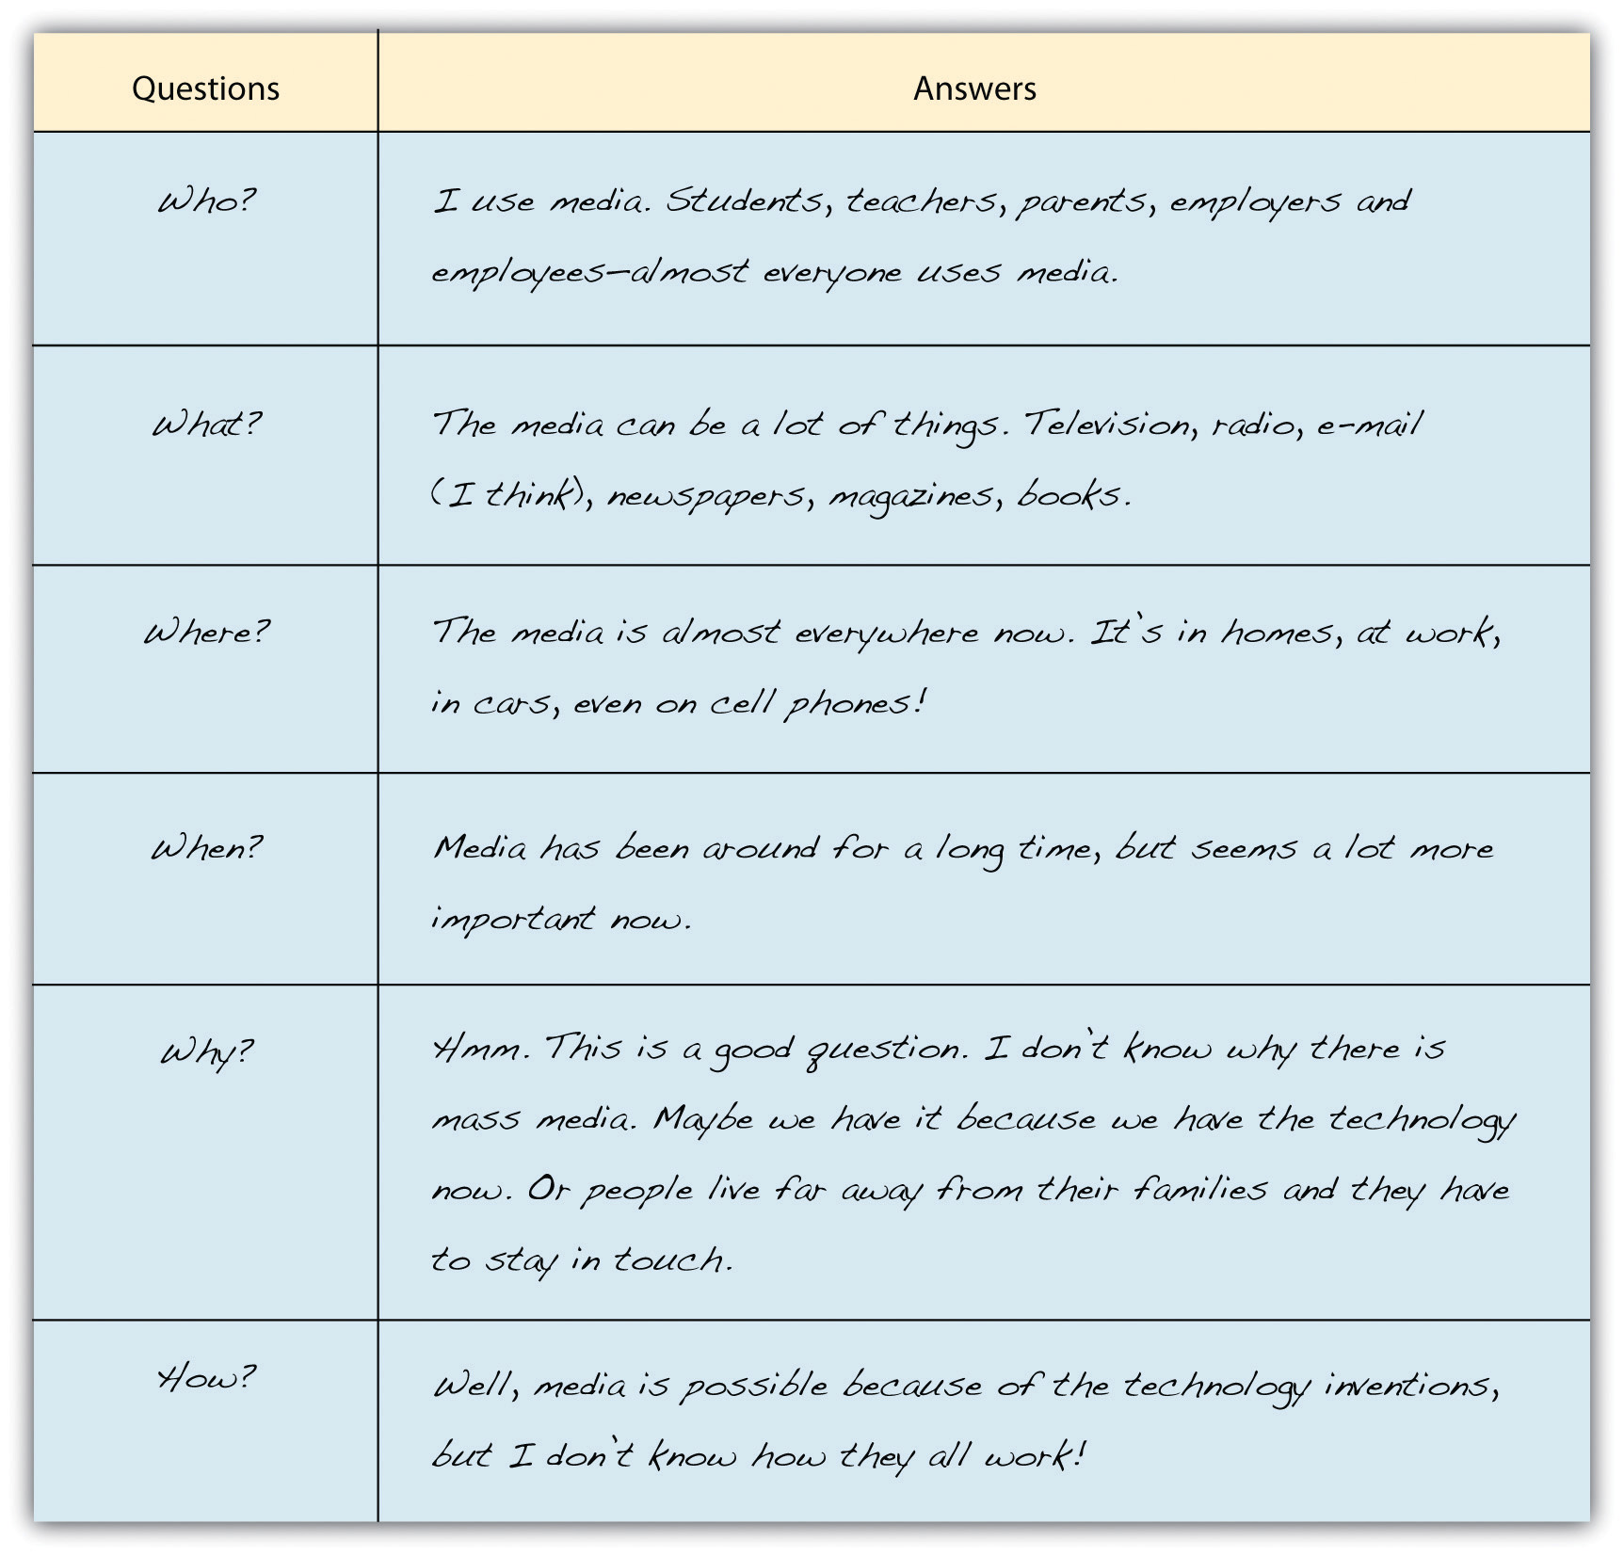
Address the Following Issues…
Are steps or concepts precisely developed?
Is all required information provided in logical and meaningful order?
Is less relevant information omitted or given less coverage?
Do graphics serve their purposes well?
Is white space used to make information accessible to audience? (formatting)
Does colour emphasize key terms or important information?
Do headings, subheadings aid clarity?

Slide 12
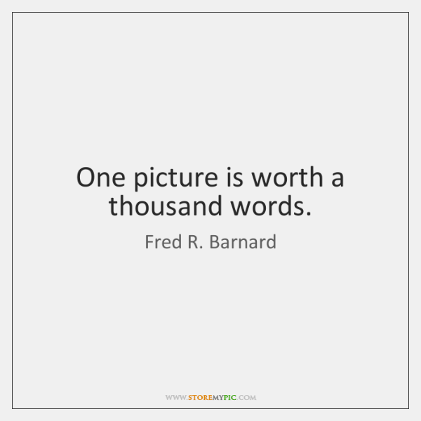

Final Look…
Choose the best methods of development
Outline your notes and ideas
Develop and integrate visuals
Construct effective paragraphs
Use quotations and paraphrasing
Write an introduction
Write a conclusion
Choose a title
Footnotes
Use spacing, indenting, underlining, numbering, and different sizes and types of lettering to make your message more understandable and visually appealing.
Citing references in the text

Slide 13
And this also…….
Your points should be lining up under these sections:
Introduction/Statement of Purpose Why you are writing and/or what you are writing about.
Background/Explanation Outline the body of your communication under the subpoints you have organized, keeping your reader in mind.
Summary/Conclusion Summarize your points.
Call for Action/Response Call for action and/or request the reader's response.

Slide 14
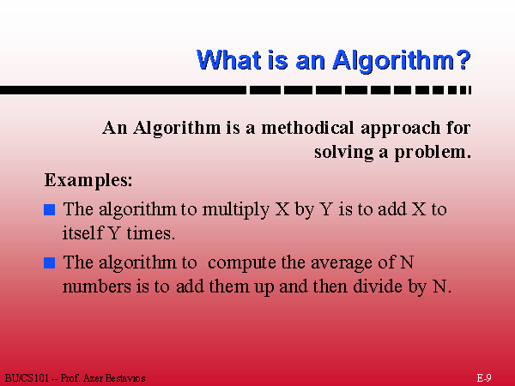
Algorithms for Complex Possibilities and Procedures
An important aspect of Organization
A well defined computational procedure
algorithm /'aelga.rio^m/ n. process or set of rules used for calculation etc., esp. with a computer. (ODCE)
A carefully planned sequence of statements, questions or instructions arranged in a logical hierarchy
A detailed step-by-step graphical technique for solving problems in a finite time
The audience can read only the starting item and such subsequent items of information as are relevant to their needs. To express the algorithm, we’ll use pseudocode (a kind of programming language)
Supplements the sine qua non to arrange information physically
The readers can easily find their route through a mass of information/a complex set of relationships or conditions (To enable readers to concentrate on finding a clear path through)
Syntactically simpler than prose

Slide 15
Importance
To present information which has complex interrelations, and to show how those inter-relations can lead to various outcomes.
To explain that various combinations of conditions can produce a particular state
To simplify the prose accounts (e.g. tax guides)’ information which can be complex.
The readers are interested in only one set of conditions, and wish to know the outcome from these only (rather than reading about all possible situations)
To present information in a way that will help audience sort out the possible relationships or conditions and isolate the set relevant to their interests.
To enable readers to find their way quickly and easily to the decisions they need.
To make the right information available for use (save the readers’ time and attract their attention)
To reduce distraction caused by unwanted information (on the part of audience)

Slide 16
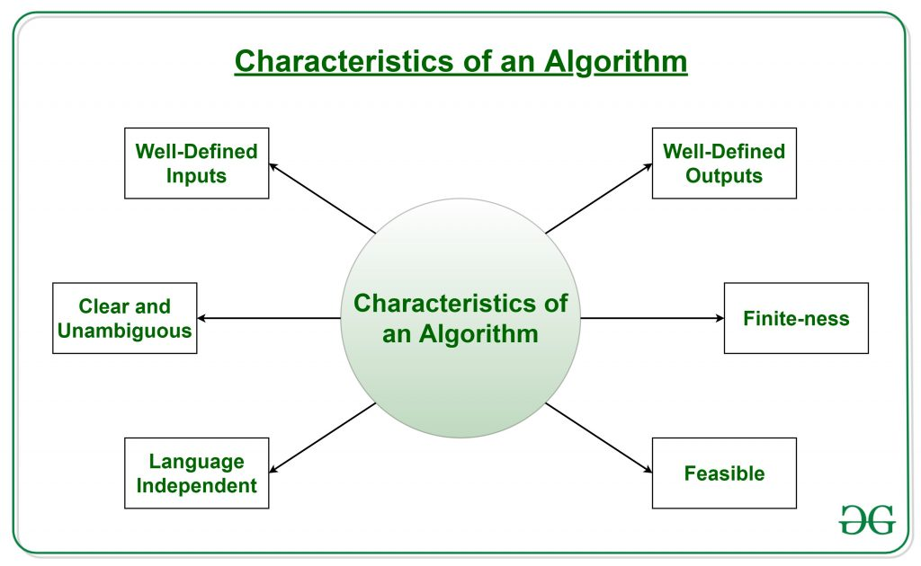
Features of Algorithm
Problem-oriented
Finiteness of description: The technique can be described by a finite text.
Effectiveness: Each step of the technique has to be feasible (mechanically) in practice.
Termination: The technique has to stop for each instance after a finite number of steps.
Determinism: The sequence of steps has to be uniquely determined/defined for each instance.
Correct: It should indeed solve the problem correctly.
Efficient: It should work as fast and economically as possible.
Generality: It should be applicable to all problems of a similar form.
Input= Initial values or quantities (taken by algorithm); Output= expected value/result (produced by algorithm)

Slide 17
The Most Common Forms of Algorithms in Engineering and Scientific Work
List-form Algorithms (presents the same information using simple numbering; it is clear and to the point and takes less space; the need for the reader’s eye to jump from item to item is, however, a disadvantage.)
Flow-charts (Logical Trees) [Clear; has the advantage of using lines to guide the reader’s eye from one item to the next; can use different symbols (squares, rectangles, diamonds, circles) to emphasize the distinction between instructions, questions, comments and conclusions; but takes more time to prepare and more space in the document.)
MAP (Maintenance Analysis Procedure) layouts (explicit and takes less space than a symbolic flow chart algorithm; it can be produced entirely by typewriter; All the elements can be typed in from a normal alphanumeric keyboard; but it has less visual impact than a symbolic flow chart.
The most suitable choice of communication tactics will depend on the aim, audience and context of the document you are writing

Slide 18
Flow-chart (Logical Trees)
Outcome 1
Scenario 1
Outcome 2
Our Project
Scenario 2
Outcome 3
Outcome 4

Slide 19
Text
Text
Text
Option
Option
Option
Option
Conclusion
Conclusion
Conclusion

Slide 20
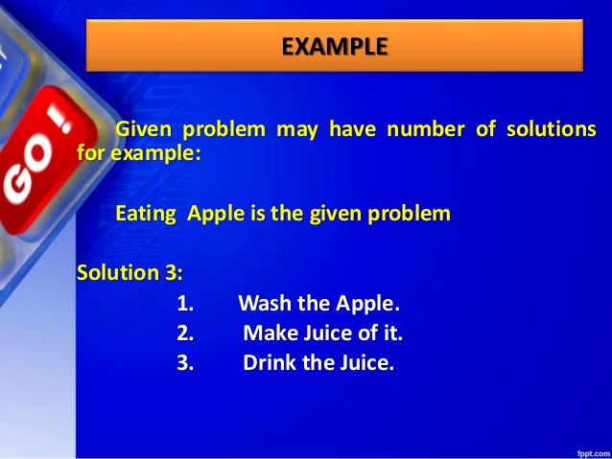
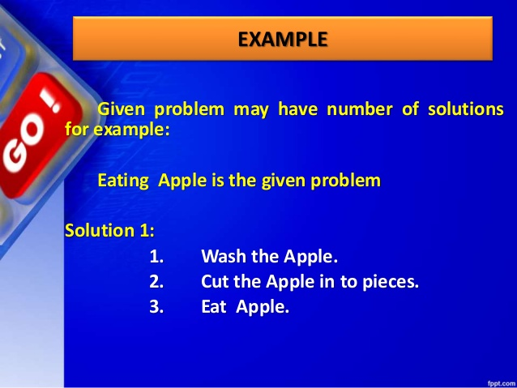
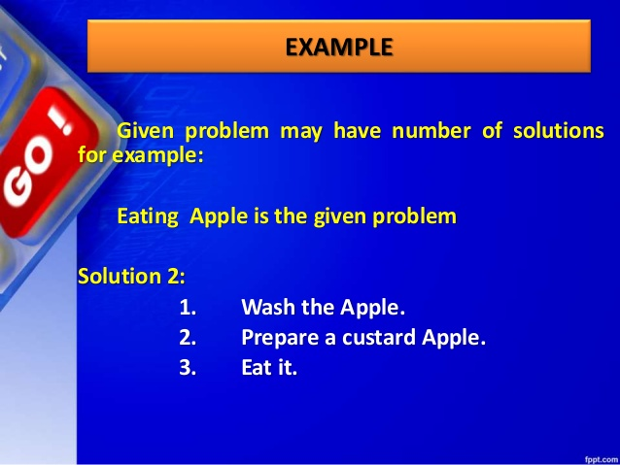
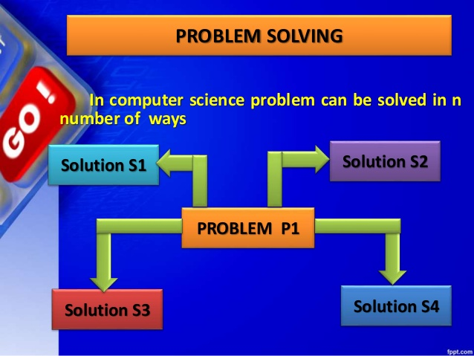
Examples
Directions to a hospital is an algorithm
A recipe for cooking meat
Finding the shortest route from Kathmandu to Bhadrapur
Eating apple strategy

Slide 21
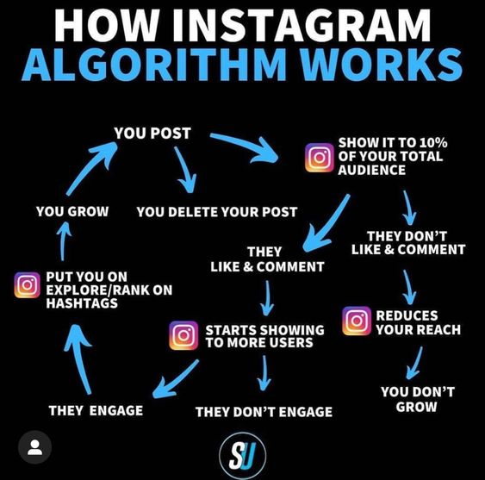

Slide 22
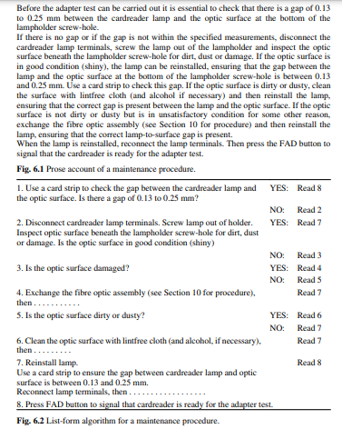

Slide 23
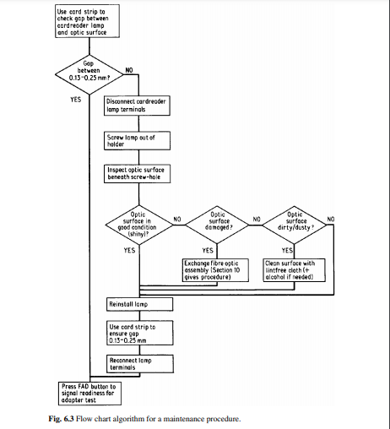

Slide 24
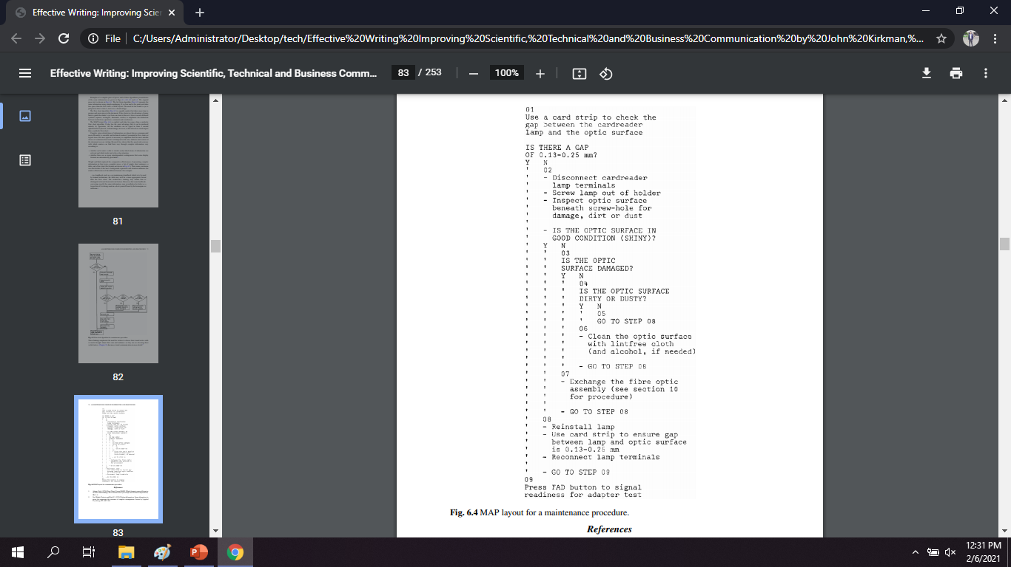

Slide 25
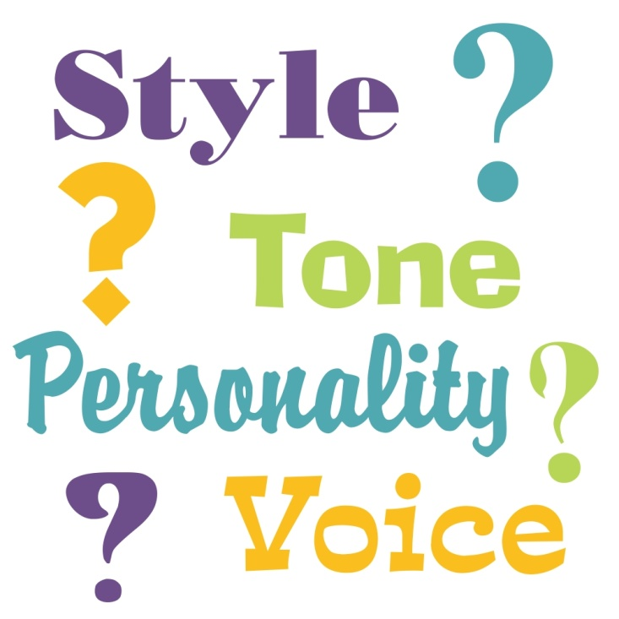
Style for Readability
What is Style?
A word usually associated with literary writing
It is a matter of the careful choice of exactly the right word or phrase
It is to adapt the language code to particular ends
A dictionary definition of style is “the way in which something is said or done, as distinguished from its substance.”
Different writers adopt different tactics.
The way they use words, sentences, images, figures of speech
Use of style depends o the context, purpose, and audience of the message
A writer’s style is the way his or her language functions in particular situations
For example, an e-mail to a friend would be relaxed, even chatty, in tone, whereas a job application cover letter would be more restrained and formal.

Slide 26
The style appropriate to one situation would not be appropriate to the other.
Various kinds of writing have distinct stylistic traits, such as technical writing style.
Style can be formal or informal
Formal: (pointing to certain material that is clearly formal, such as scholarly and scientific articles in professional journals) By using such techniques as the active voice whenever possible, sentence variety, and subordination, a writer can make formal writing lively and interesting
Informal: a relaxed and colloquial way of writing standard English; found in most personal e-mail and in some business correspondence, blogs, and promotional writing; the tone is more personal than in formal writing
Attempting to impress readers with a flashy writing style can lead to affectation; attempting to impress them with scientific objectivity can produce a style that is dull and lifeless. Technical writing need be neither affected nor dull.
It can and should be simple, clear, direct, even interesting—the key is to master basic writing skills and always to keep your readers in mind.

Slide 27
Technical Writing Style
The goal of technical writing is to enable readers to use a technology or understand a process or concept
The subject matter is more important than the writer’s voice
Uses an objective, not a subjective, tone
The writing style is direct and concise
Emphasizing exactness and clarity rather than elegance or allusiveness
Uses figurative language only when a figure of speech would facilitate understanding
Audiences may be inexperienced and the procedures described may involve hazardous material or equipment; hence clarity becomes an ethical as well as a stylistic concern.
The writers can use visuals as well as layout and design to enhance clarity, providing the reader with both text and visual information.
Technical writing style uses a technical vocabulary appropriate for the reader

Slide 28
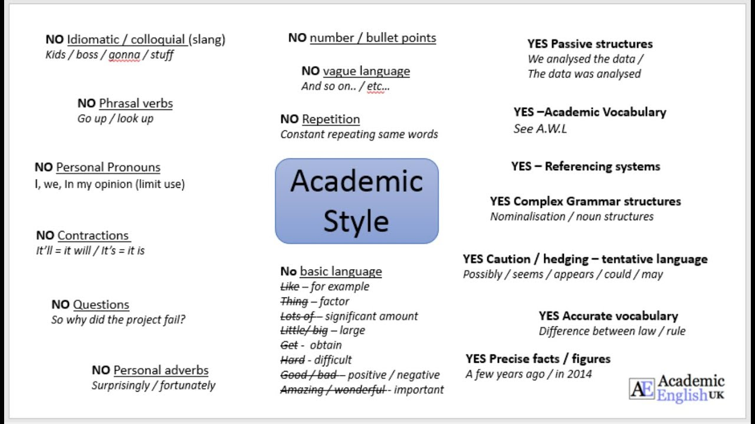
Developing an Effective Style
Use the active voice—not exclusively but as much as possible without allowing your writing to become awkward or illogical.
Use parallel structure whenever a sentence or list presents two or more thoughts of equal importance.
Vary sentence structure to avoid a monotonous style.
Avoid stating positive thoughts in negative terms (write “40 percent responded” instead of “60 percent failed to respond”).
Use plain language, and positive writing.
Concentrate on achieving the proper balance between emphasis and subordination.
Use Powerful Words: Verbs are your friends. They will happily carry your meaning if you select the correct ones. Verbs enliven your writing and turn passive statements into active ones, if you pick them from the active side of the family. And don't stop at active verbs; select colorful, precise, and vibrant ones.

Slide 29
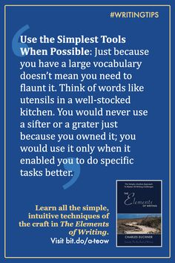
Why does style matter?
To achieve the aim of comfortable, readable writing
To make a scientific writing easy to read
To make the writing efficient
To avoid extra barriers between the message and the readers

Slide 30
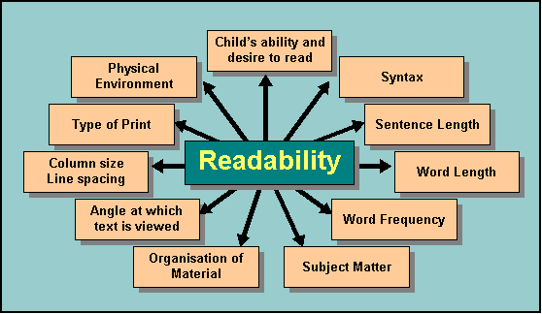
Readability Research
Readability is a quality of your writing
It is a measure of how easy a piece of text is to read
Ability of letting sb comprehend the code clearly
An important part of content management
Making content clear and easy to understand for the largest audience possible
Focusing on readability increases the chance that the target audience will actually read and interact with the published content
If the readability of your text is high, people will be able to understand your sentences easily
The first stage in acquiring an effective and readable style is to understand the factors which contribute to unreadable writing.

Slide 31
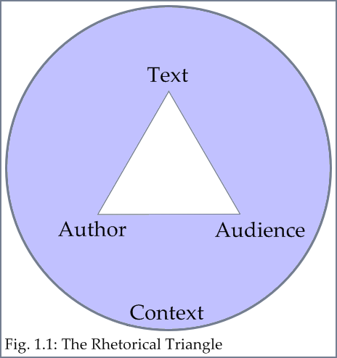
Writer, Text and Reader
3 interrelated factors that impact readability
the writer, principally by careful selection of material, by organization, signposting and variation of emphasis, affects the readability of the text.
Both the language (structures and vocabulary) and the physical appearance (layout, headings, white space) contribute to the efficiency of the communication. (the text)
the readers’ motivation and attitudes contribute to their responses to the text; whether readers find what they expect to find in a text affects their attitudes, and therefore the text’s readability.

Slide 32
Other Aspects to Remember
Long Sentences: Difficult to grasp; overfill the short-term memory and the information is lost; the writer of long sentences risks making readers inattentive.
Adjusting Sentence Length: Any subject can be broken up into longer or shorter items of information at will; sentence length should be determined by what the reader can effectively decode; break down long sentences into more manageable ones; look for connecting words (‘and’, ‘but’, ‘if’, ‘also’), the logical ‘glue’ between the groups of technical words.
Flexible Sentence Length: Avoid dogmatic length for sentences; Variety is valuable since it aids attention, and makes reading more interesting, so sentence lengths should vary in order to make ever-varying demands on the reader; Complicated information should be in shorter sentences; Intelligent use of sentence length and structure is an important ingredient of effective style for informative writing.
Using Layout: Paragraph breaks, headings, indentation, and other devices of layout help to present complex information effectively

Slide 33
Cont.…
Long Words: the use of long and unfamiliar words is injurious to writing; Words which are infrequently used are likely to be unfamiliar; they are less easy to read for that reason; Long words do not impress; readers cannot understand them; Long words confuse; the precise meaning of each word may not be clear; Modern sciences and technologies are impressive enough in themselves; they do not need any adornment
Jargon: An important resource; A short and convenient way to name new ideas and concepts; special word or expression used by a profession or group that is difficult for others to understand; technical communication would be cumbersome and inefficient without it; don’t use for wrong reasons; if jargon is used aggressively, carelessly and unnecessarily, it impedes communication; if used without having a specific and real function in the communication of the message, it reduces readability
Ladders of Abstraction: Long, unfamiliar words are often highly abstract, and fail to communicate because they embrace too many different meanings; readers cannot decode clear ideas or images

Slide 34
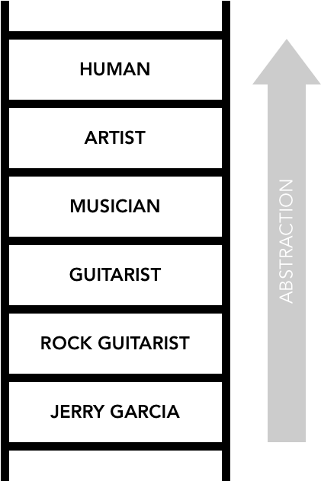
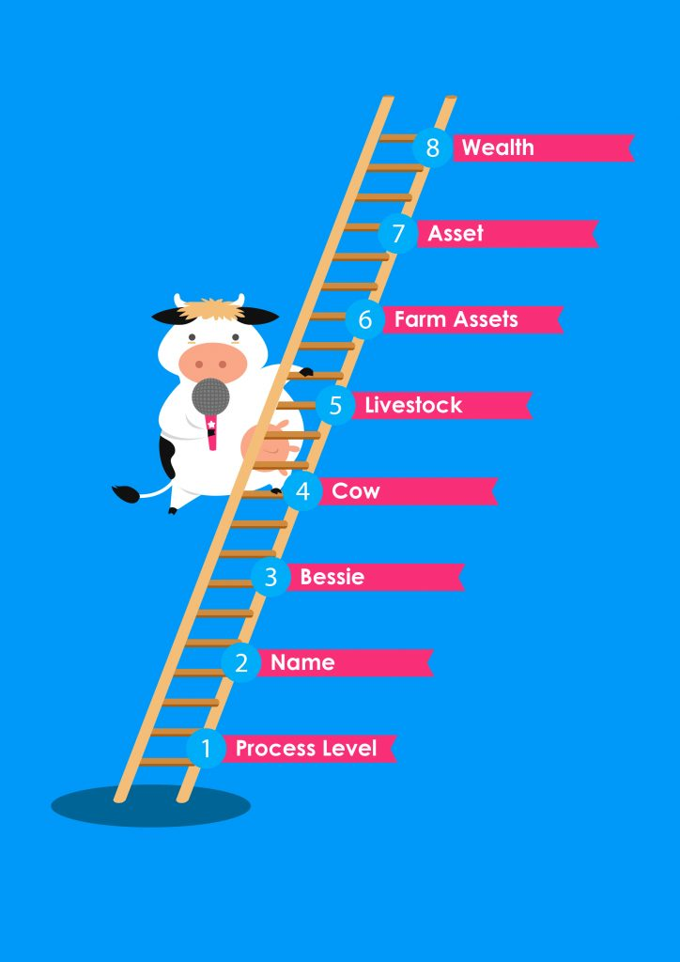
Ladder of Abstraction
There are hierarchies of increasingly abstract and general terms. For examples, names such as:
Construction
Building
Dwelling
House
Each term higher on the list covers a larger area.

Slide 35
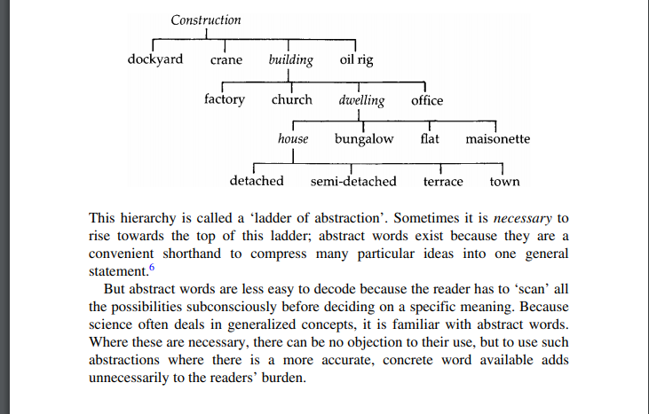

Slide 36

Other Terms to Consider
Unnecessary words: Unnecessary words/phrases often repeat an idea which is already expressed in another word, and thus waste space and blunt the message
Redundant words: When we use two or more words together that mean the same thing, for example, ‘blunder mistake’ (KISS)
Nominalization: the use of a word which is not a noun as a noun; “decision” is a nominalization of “decide,”; Where writing continually nominalizes, it becomes tiring and flat: more effort is required to disentangle the roundabout structures which result, the meaning is spread more thinly, and the passive structures with meaningless general purpose verbs rob the writing of its impact and energy
Passive: it reverse the most common order of a sentence; A normal variety of structures should be used, including occasional personal references, with a limited number of passives.
Personal versus Impersonal

Slide 37
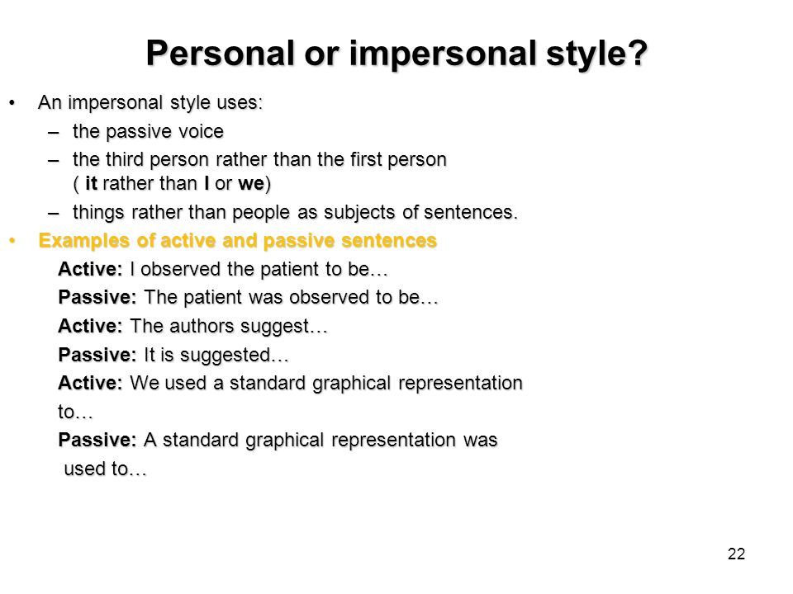
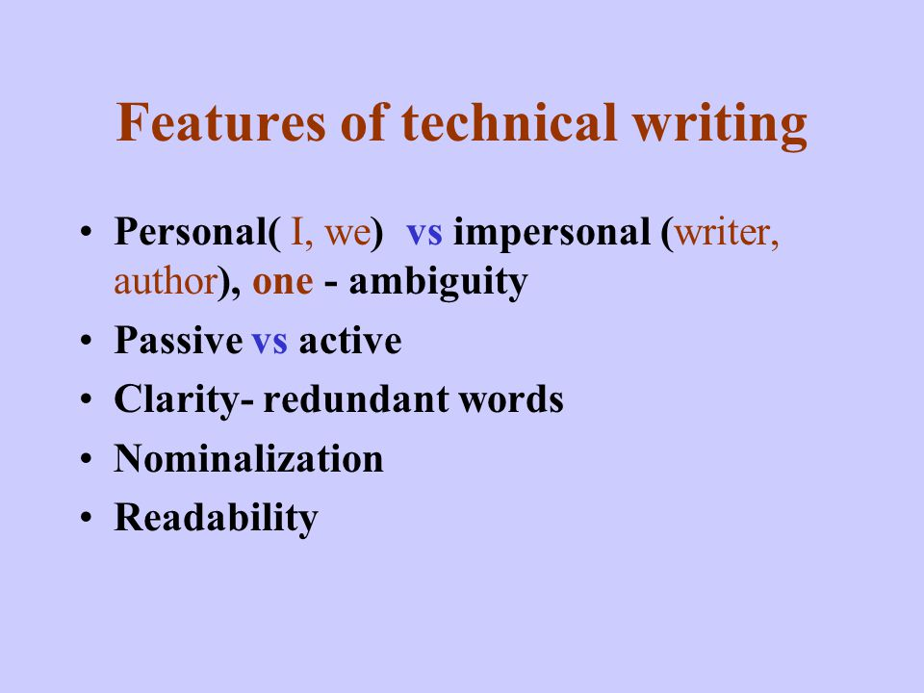

Slide 38
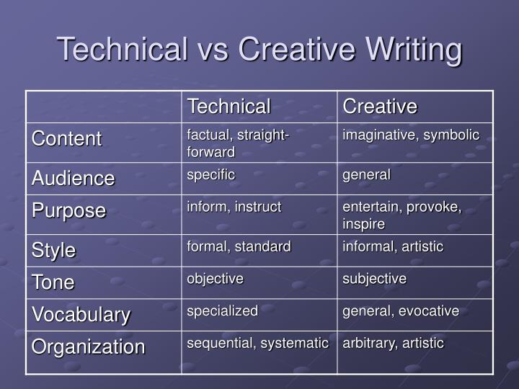
Before Leaving Style…..

Slide 39
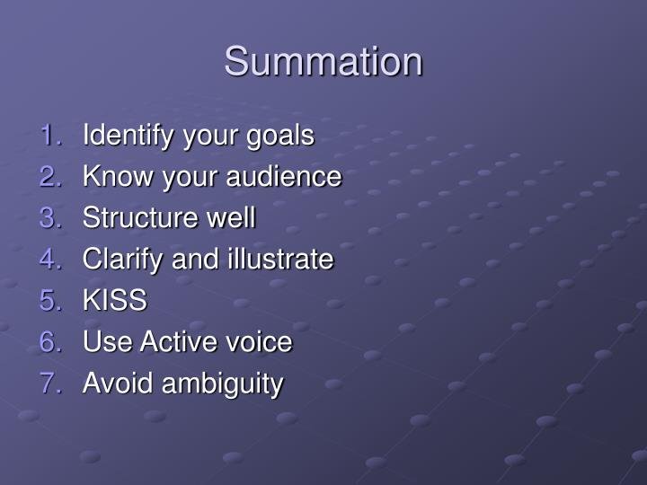

Slide 40

Computer for Writing
Computer as a norm of the 21st century literacy and culture
Widely used by many writers for their writing
Simply, writing with a computer
Can be a crucial technical writing tool
Many specialties which aid writing: to keep writers on the point, highlight possible spelling mistakes
Valuable tools: word processing, speech recognition, speech feedback, word prediction, and other varieties of software packages
Word processing programs, spelling checkers, on-line dictionaries, online style and grammar manuals are useful for the editing

Slide 41
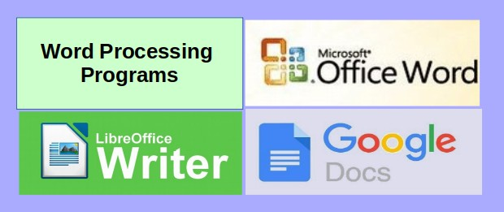
Using a Word-processor
The most common computer application/device
WP: A software that allows the users to create, edit and print documents
Processes words (paragraphs, pages or papers)
Microsoft Word as the most popular word processor (among WordPerfect (Windows only), AppleWorks (Mac only), and OpenOffice.org)
used to write and revise documents, compose the layout of the text, and preview on a computer monitor how the printed copy will appear

Slide 42
Fundamentals
Using a WP makes writing easier but it does not change the axioms of good writing
Word-processing changes the way text is created and extended, and the ways in which writers think and work
The main advantage of the word-processor is the ease with which mistakes can be corrected
Clean copies can be produced without the need to re-type the whole document
Clear copy of document can be printed once it is revised and is error free
Writing with a word-processor might not involve any changes in processes or in the resulting products
Writing with a word processor might involve some changes in processes, but without any obvious effects on the resulting products.
Can simplify the revising process: delete, insert, and move commands allow writers to rearrange text without recopy it
word processors can give writers more freedom than paper and pencil based writing because writers can compose text sequentially, follow an outline, or insert ideas at any point in a text

Slide 43
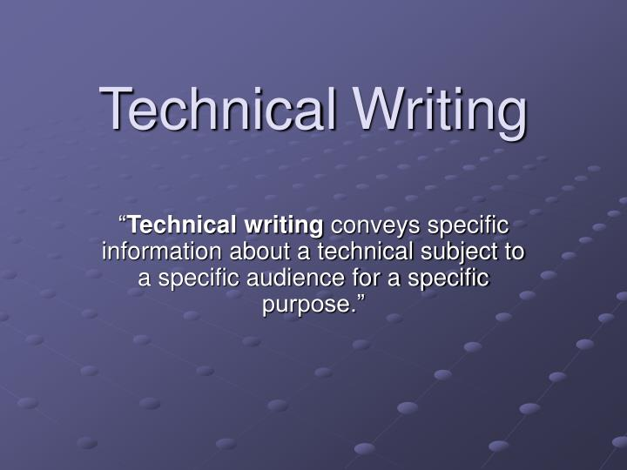
Pulling Back

Slide 44

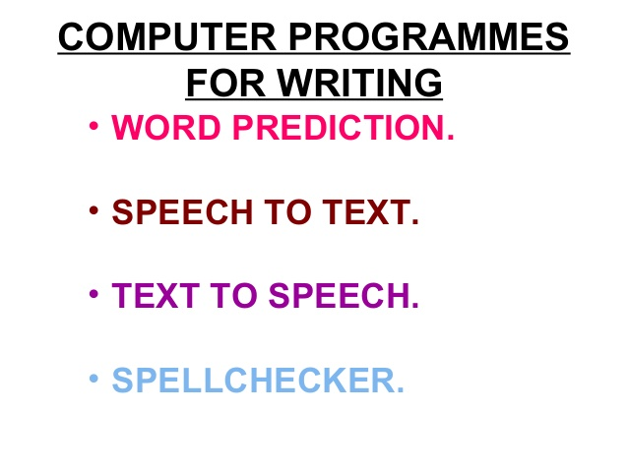

Slide 45
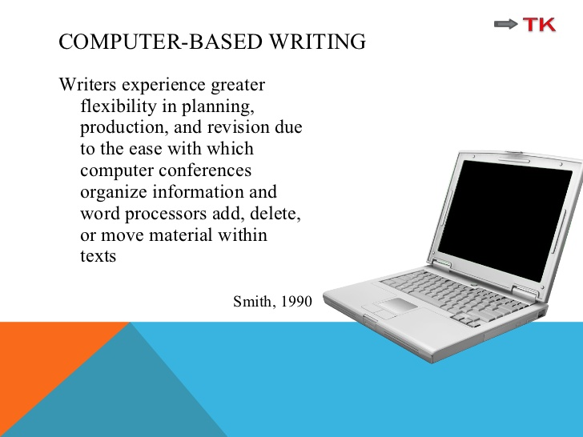

Slide 46
Advantages | OOPS
Use of computer for writing can save time and labour | Computers cannot think; they cannot compose texts for the writers (They cannot decide what information you need in a letter replying to a customer’s enquiry)
Writer can write down whatever that comes in their mind, then revise the text and change the text as per their requirement | They cannot decide which information goes where
Use of word-processors encourages smooth flow of idea in writing | They cannot decide how much data to include in your progress report
Easy and repeated revision is an enormous benefit that word-processing confers on the writer | They cannot choose the most persuasive way to organize and express the information
Convenient to review the readability of text | The writers should re-read the whole section of text to check for awkward joints and unexplained references

Slide 47
A Closer Look at CAW…
Not required to re-write all the text from top to bottom just to change that one word (vs. written/pen and paper)
Writers using pen and paper are tempted to pause and try to get things “right” the first time through; flow interrupted
Ideas and facts can be inserted quickly into the appropriate section of the documents
The word processor encourages revision of style, because it shows the writer immediately on the screen the effect of breaking long sentences or reconstructing clumsily expressed phrases and clauses.
Saves energy and time: , the mechanical labour of producing and sub-editing texts is small
The ability to manipulate language in word-processors will never relieve writers of the ultimate responsibility for writing varied, interesting and intelligent texts
Grammar-checkers: the ability to recognize grammatical features could also be used intelligently
Spelling-checkers and diction-checkers (computer-based ‘tools’)
Suggests to change clumsy or cliche-ridden phrasing

Slide 48
Warning!
Word-processors may save a typist’s time in drafting and final typing of a text: but if badly organized ideas, formulated in a verbose and vague style, are put into the machines, then the final text may look superficially attractive but it will be just as tedious for readers as any manually retyped text
Verbosity: The ease with which machines will convert our ramblings into text will seduce us into undue loquacity
Word-processors can encourage monotonous repetition of words or whole chunks of text
Used intelligently, they can save time; used thoughtlessly, they can increase the unreadability of texts
Speed and ease of revision can tempt writers to become increasingly slipshod in the composition of their first drafts
The overall cost of the completed document is as high as, or higher than, that of a normally typed document (many drafts)
Hence, the development of word-processors will not remove the need for attention to basic techniques of writing

